Slide 1

CUSTOMER OVERVIEW · 2026
COMPLETE ASSET INTELLIGENCE
Tag. Track. Manage.
Eliminate ghost assets. Gain real-time visibility. Stay audit-ready — by design.
KEYCOMAGIX.COM
01 / 18

Slide 2
02 — THE PROBLEM
WHY THIS IS BROKEN
Organizations bleed money on assets they can't find, verify, or trust.
30%
$1.7T
8th
87%
of fixed assets are "ghost assets" — recorded but missing
in DoD assets that cannot be accounted for
consecutive year the Pentagon failed its audit
reduction in asset loss after deploying Keyco
STALE SPREADSHEETS
NO PROOF AN ASSET EXISTS
COSTLY RFID INFRASTRUCTURE
SILOED SYSTEMS, NO UNIFIED VIEW
THE PROBLEM
02 / 18

Slide 3
03 — THE DUB-FIRST SOLUTION
PHYSICAL IDENTITY GATING · PATENTED
Every asset record has a real, verified physical counterpart.
STEP 01
STEP 02
STEP 03
Unique Identity
Claim
Live Intelligence
Every DUB ships with a pre-encoded, tamper-proof UUID. Duplicates are detected and rejected instantly.
Scan with any smartphone — no app required — to securely bind the tag to a new asset record.
Every scan, tap, or movement generates location, timestamp, and user data — feeding analytics in real time.
NO DUB → NO ASSET RECORD. BY DESIGN.
THE SOLUTION
03 / 18

Slide 4
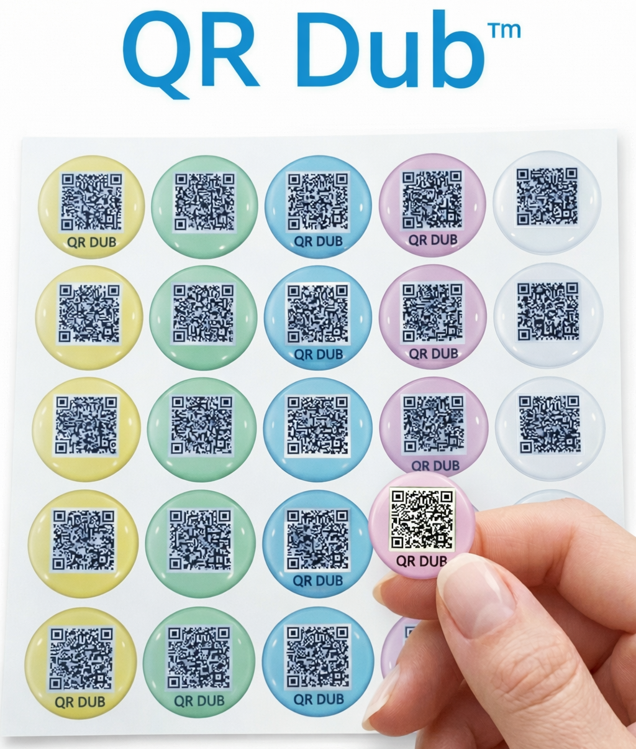
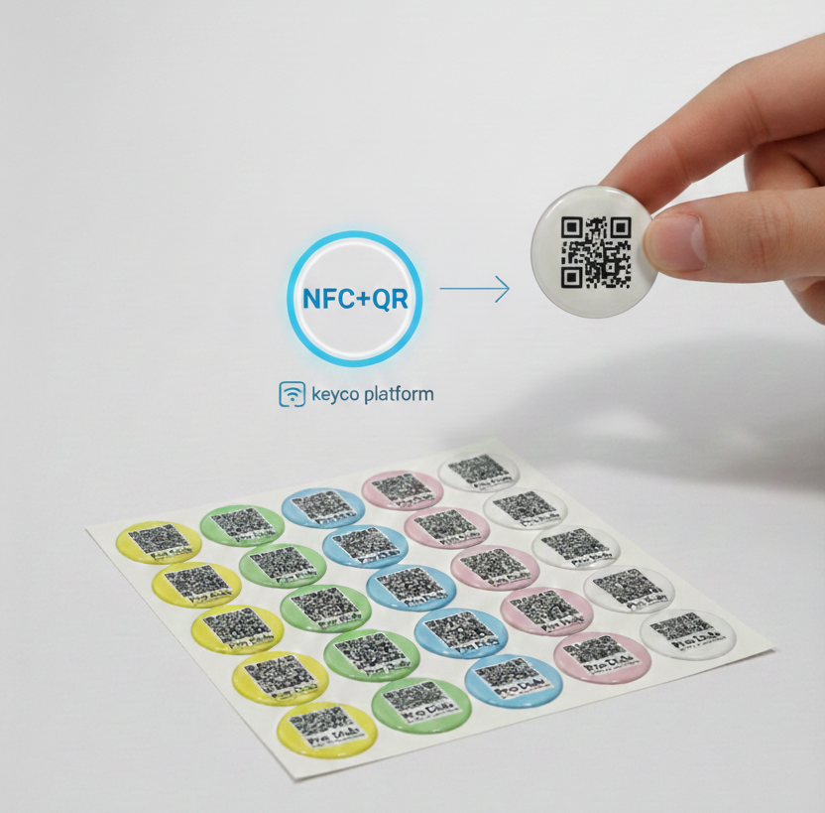
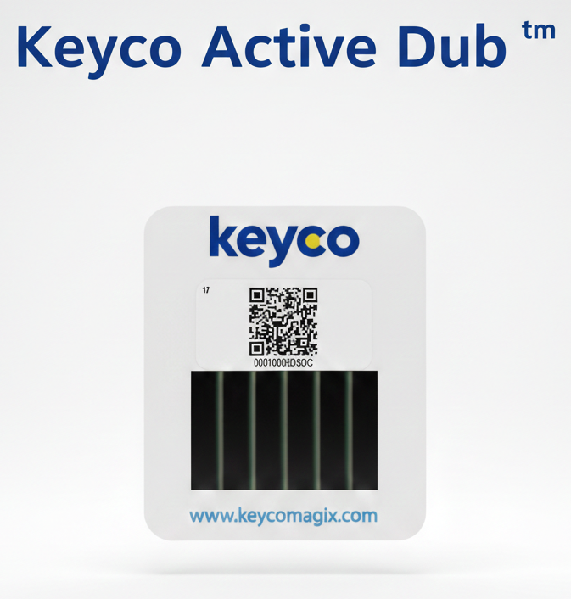

04 — THE DUB ECOSYSTEM
ONE PLATFORM, FOUR PRIMITIVES
The right tag for every asset.
QR DUB · $
PRO DUB · $$
ACTIVE DUB · $$$
DIGITAL DUB · $$
Scan-to-track
Tap-to-track
Live tracker
Software agent
High-volume, cost-sensitive assets. Instant scan with any smartphone camera — no app required.
NFC + QR dual-mode. One-handed, glove-friendly tap. Faster check-ins for high-frequency use.
Batteryless BLE. Real-time location, motion + temp sensors, geofence alerts. 10+ year lifespan.
No sticker — devices auto-register on agent install. Real-time GPS + telemetry for any IT fleet.
Enterprise strategy: QR for volume, Pro for high-value, Active for mission-critical, Digital for IT — all unified in one dashboard.
DUB ECOSYSTEM
04 / 18

Slide 5
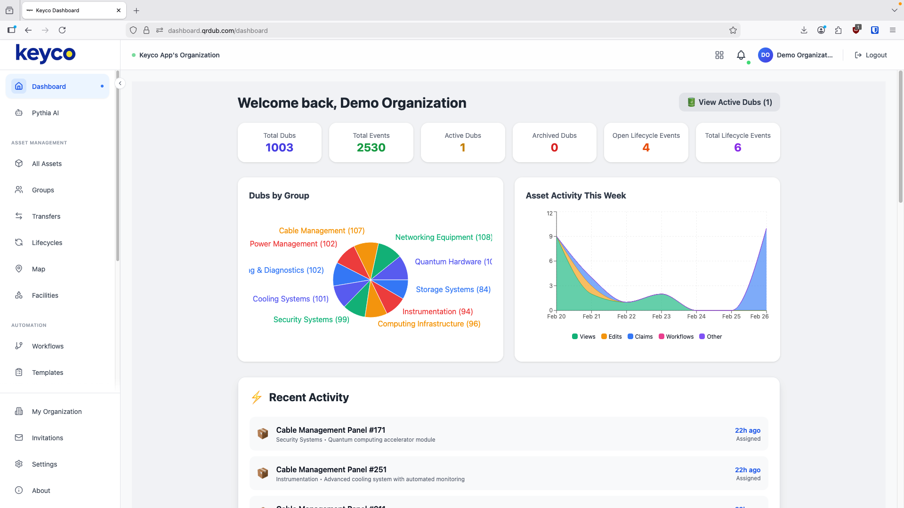
05 — COMMAND CENTER
THE DASHBOARD
dashboard.qrdub.com
Your entire portfolio at a glance.
Real-time totals, asset activity trends, and breakdowns by group — the first thing your team sees, every day.
Total DUBs, events, lifecycle counts
Asset activity trends, last 7 days
DUBs by group breakdown
Recent activity feed
COMMAND CENTER
05 / 18

Slide 6
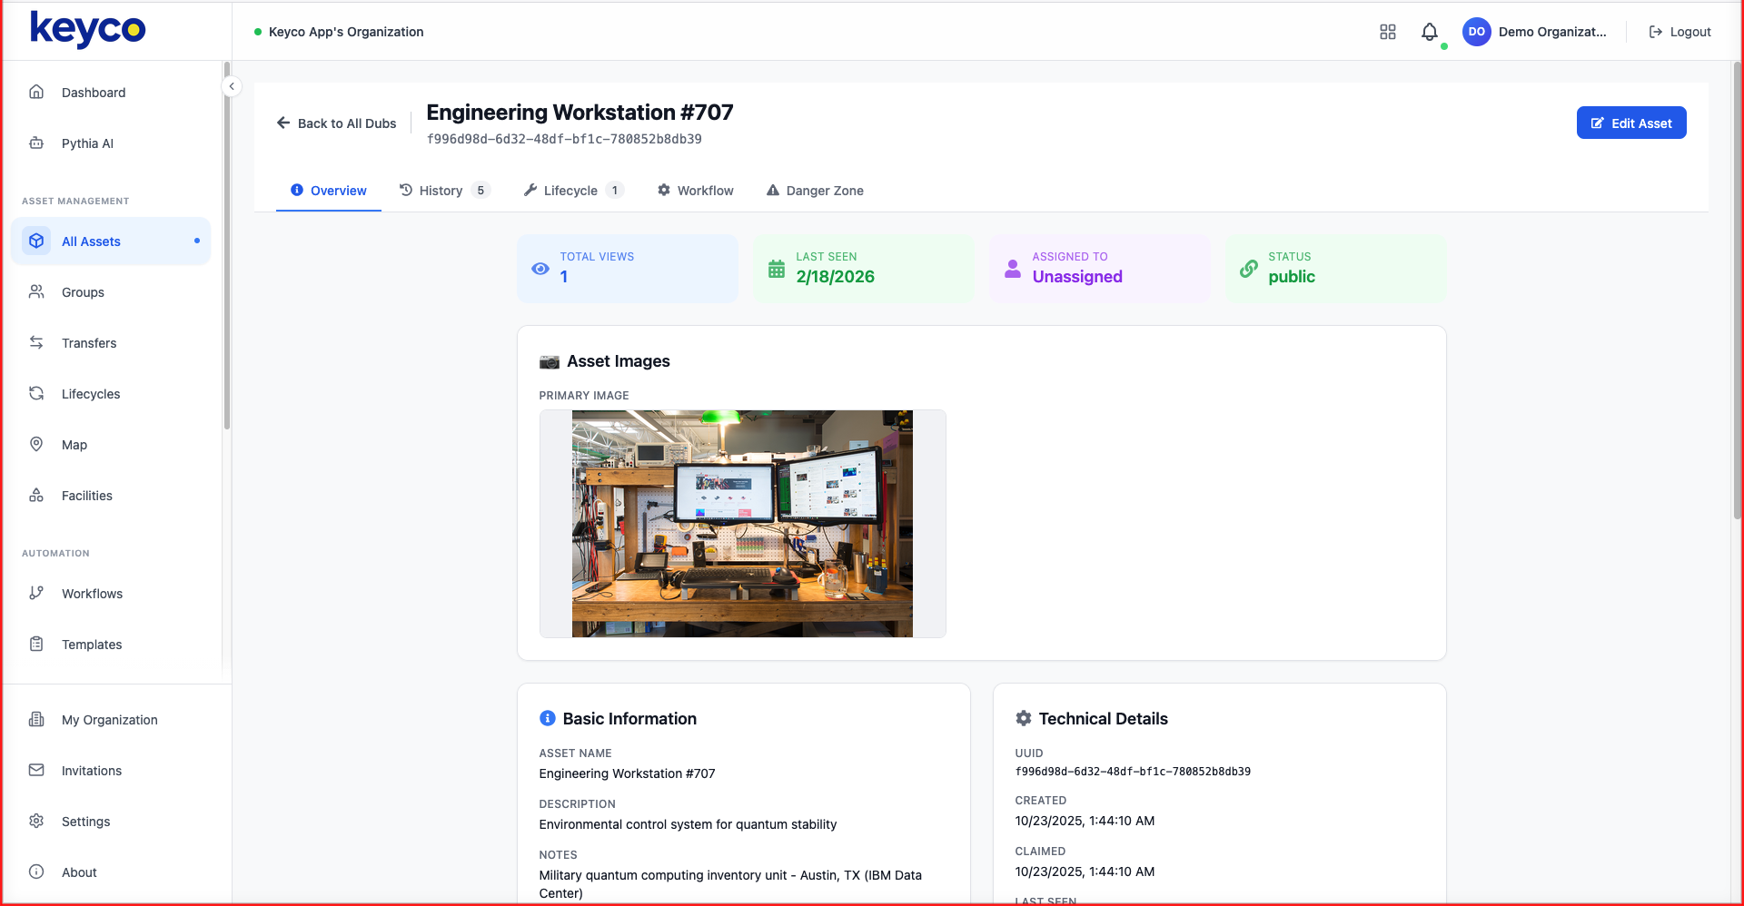
06 — DEEP ASSET INTELLIGENCE
dashboard.qrdub.com / assets / 707
ASSET PROFILE
Every asset, fully profiled .
Photos, metadata, technical specs, assignment history — all bound to a UUID that proves the asset is real.
Status, last seen, assignment
Asset images & technical details
Cryptographic UUID & timestamps
ASSET INTELLIGENCE
06 / 18

Slide 7
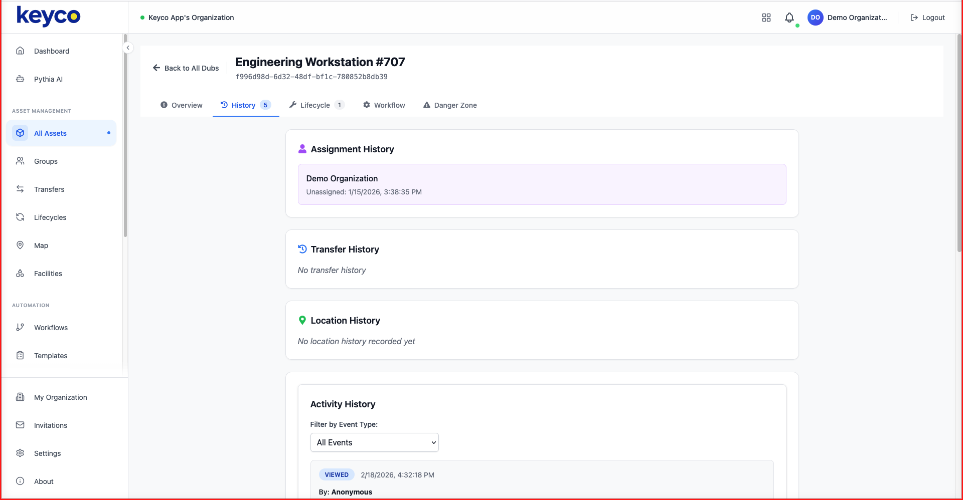
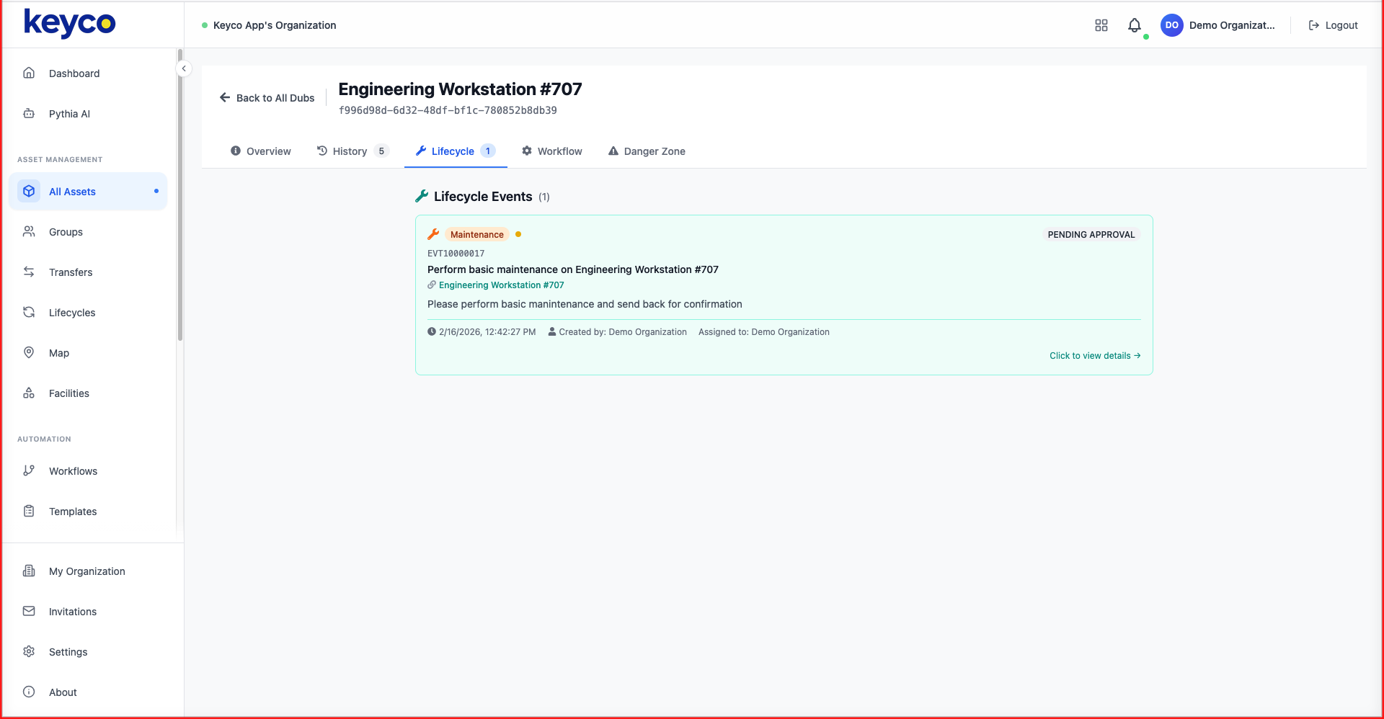
07 — HISTORY & LIFECYCLE
FULL AUDIT TRAIL
From creation to disposal — every event, signed.
ASSIGNMENT & ACTIVITY
LIFECYCLE EVENTS & MAINTENANCE
/ assets / 707 / history
/ assets / 707 / lifecycle
HISTORY & LIFECYCLE
07 / 18

Slide 8
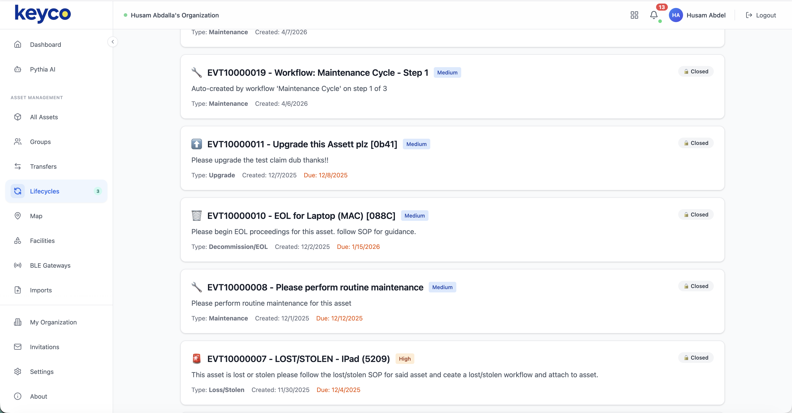
08 — LIFECYCLE & WORK ORDERS
NEW · LIFECYCLE MANAGER
dashboard.qrdub.com / lifecycles
Every event. One audit-ready log.
Maintenance, upgrades, EOL, lost/stolen — every lifecycle event captured with priority, due date, status, and full chain of custody.
Auto-created from workflows — multi-step cycles spawn events
Priority + due dates with overdue flagging
Filed against the asset — permanent, signed, tamper-evident
LIFECYCLE MANAGER
08 / 18

Slide 9
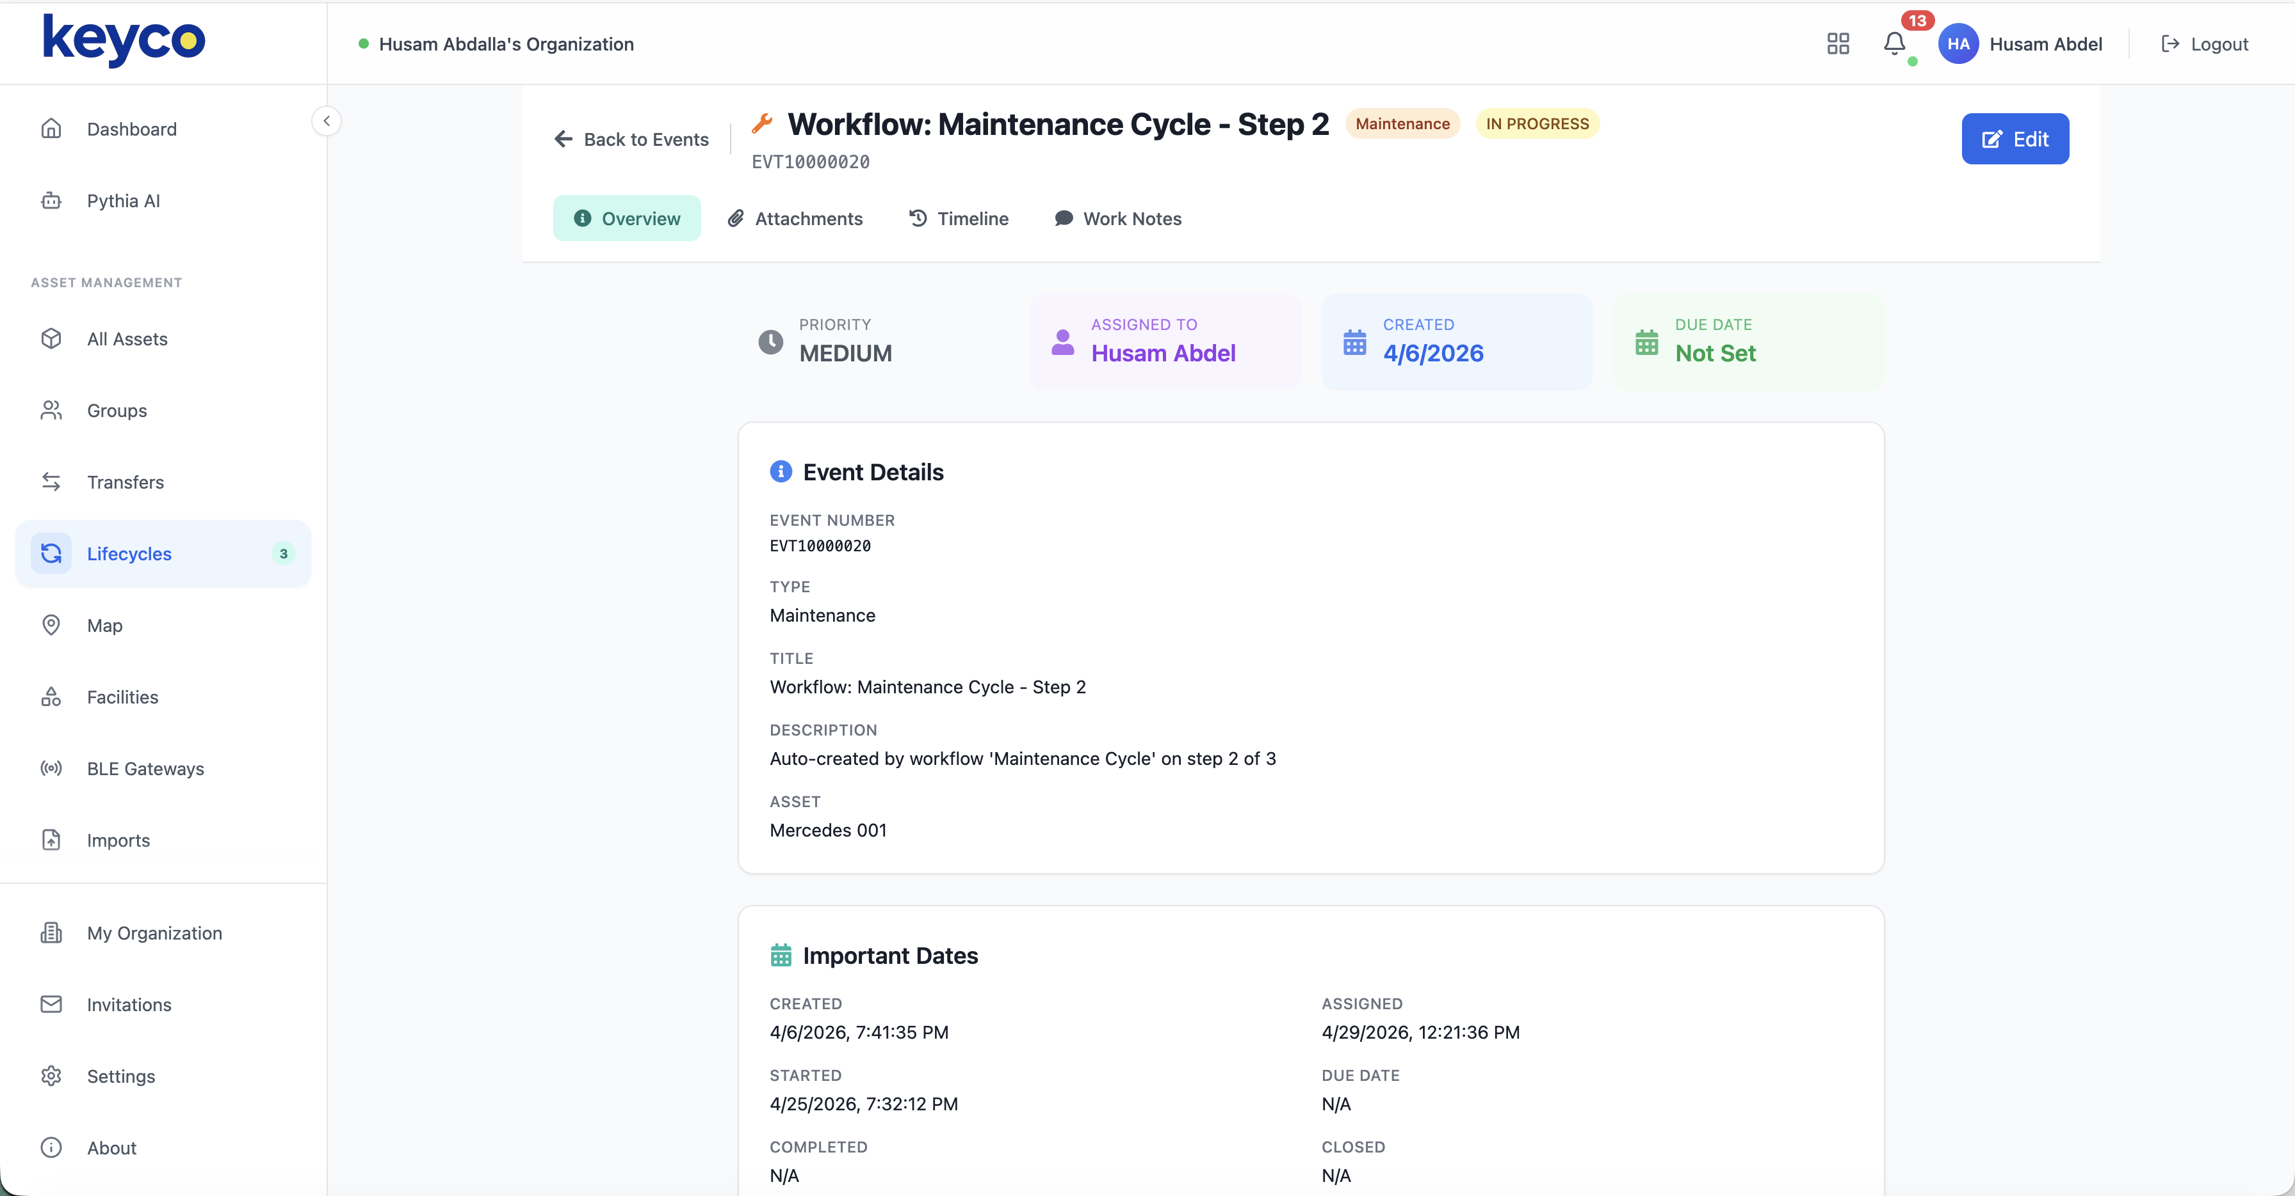
09 — WORK ORDER DETAIL
DRILL INTO ANY EVENT
/ events / EVT110000020
More than a ticket — it's forensic.
Each event captures its own assignment, work notes, attachments, full state transition timeline, and the asset it's bound to.
OVERVIEW
ATTACHMENTS
Status & priority
Photos & SOPs
TIMELINE
WORK NOTES
Every state change
Field commentary
WORK ORDER DETAIL
09 / 18

Slide 10
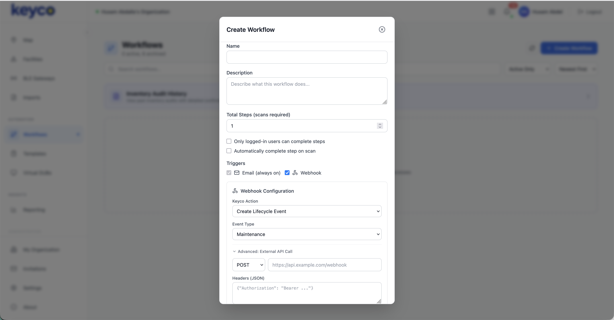
10 — AUTOMATED WORKFLOWS
NEW · WORKFLOW ENGINE
Compose any process . Wire it to anything.
/ workflows / new
Multi-step workflows with email + webhook triggers. Wire Keyco to your CMMS, ERP, or ticketing system — without writing integration code.
Multi-step scan-required workflows
Email + Webhook triggers — POST/PUT to any API
Custom headers + auth — Bearer, JSON payloads
Auto-create lifecycle events
WORKFLOWS
10 / 18

Slide 11
11 — REAL-WORLD TRIGGERS
PHYSICAL EVENT → DIGITAL ACTION
A real-world signal runs your process.
TRIGGER
→
WORKFLOW
→
ACTION
QR / NFC scan
MAINTENANCE CYCLE
Email notification
A worker taps an asset
3-step procedure
Owner, manager, team
BLE movement
1
Inspection scan Scan-required step at the asset
Webhook → CMMS / ERP
Geofence enter / exit
2
Service performed Auto-creates lifecycle event
POST to any system
Sensor event
3
Verification scan Closes the loop, signs the record
Lifecycle event
Motion, temp, vibration
Auto-filed against asset
Schedule
Custom API call
Time-based recurrence
Bearer auth, JSON
TRIGGERS → ACTIONS
11 / 18

Slide 12
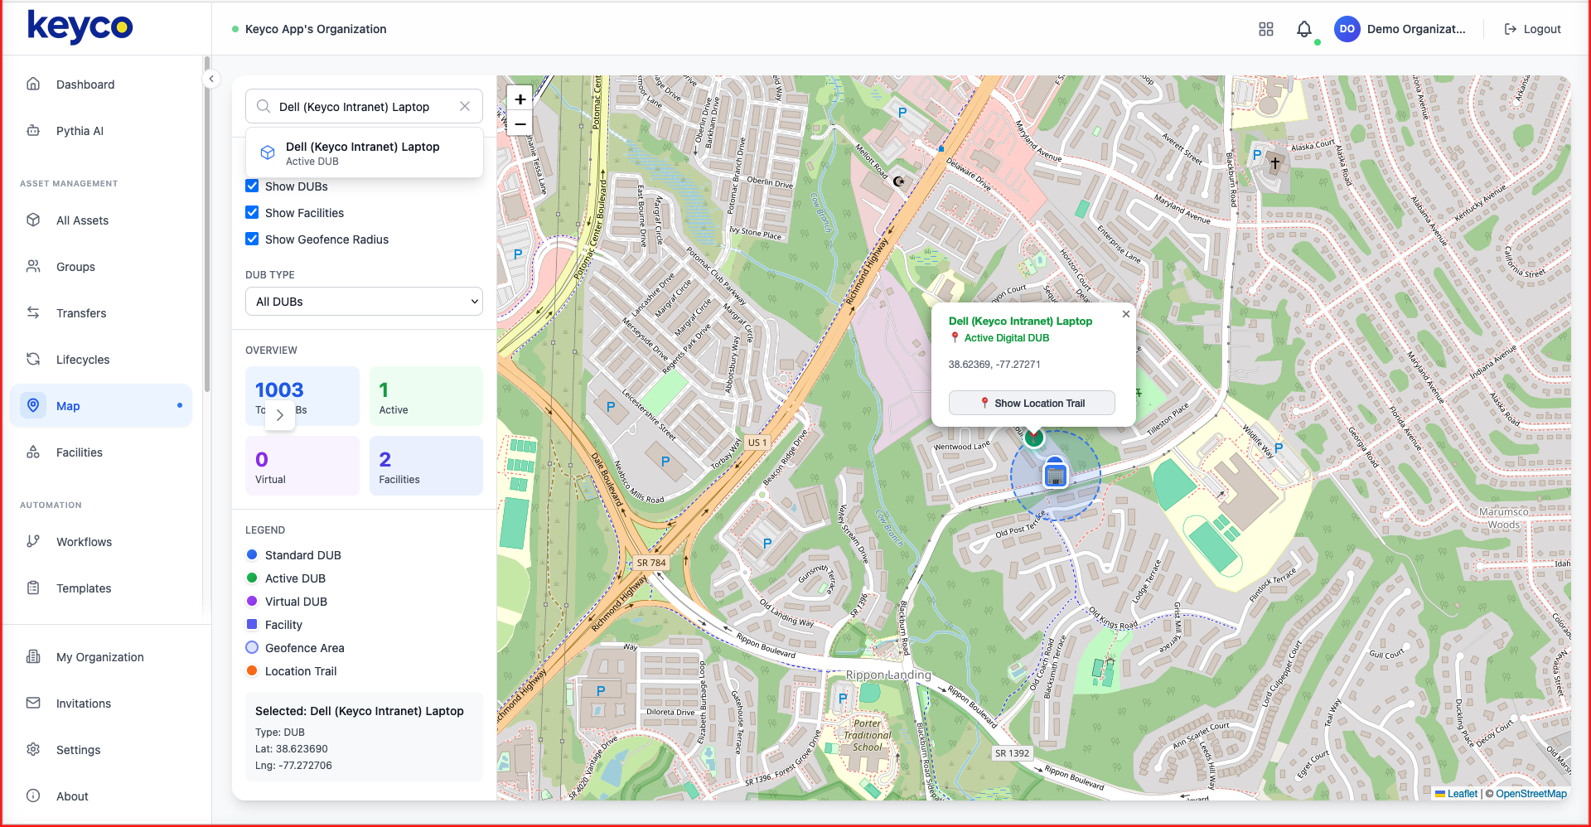
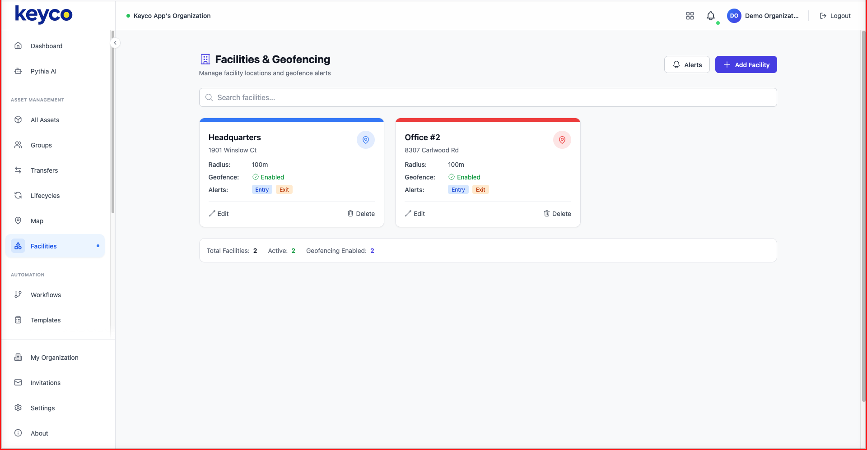
12 — REAL-TIME MAP & GEOFENCING
LIVE LOCATION INTELLIGENCE
Every asset on a live map.
ASSET SEARCH & LOCATION TRAIL
FACILITIES & GEOFENCE MANAGEMENT
/ map
/ facilities
Set boundaries, receive entry/exit alerts, and trail an asset's path across any facility.
MAP & GEOFENCING
12 / 18

Slide 13
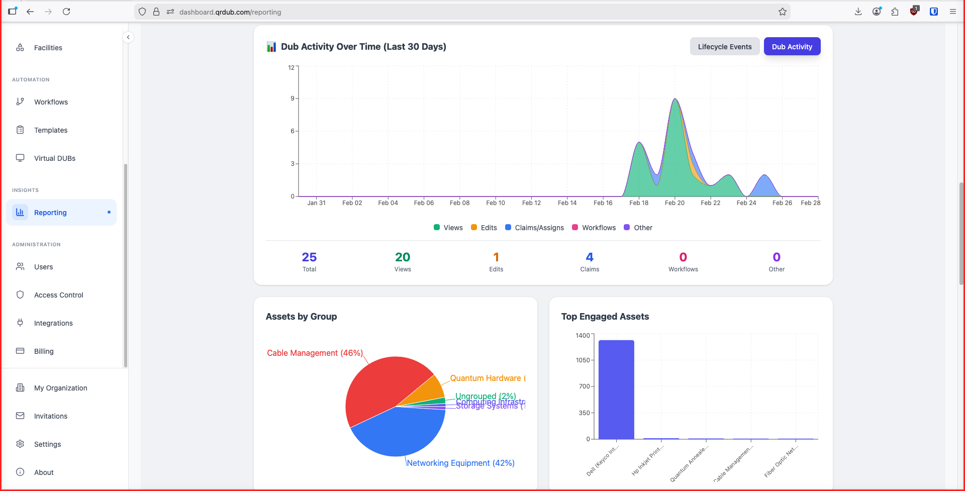
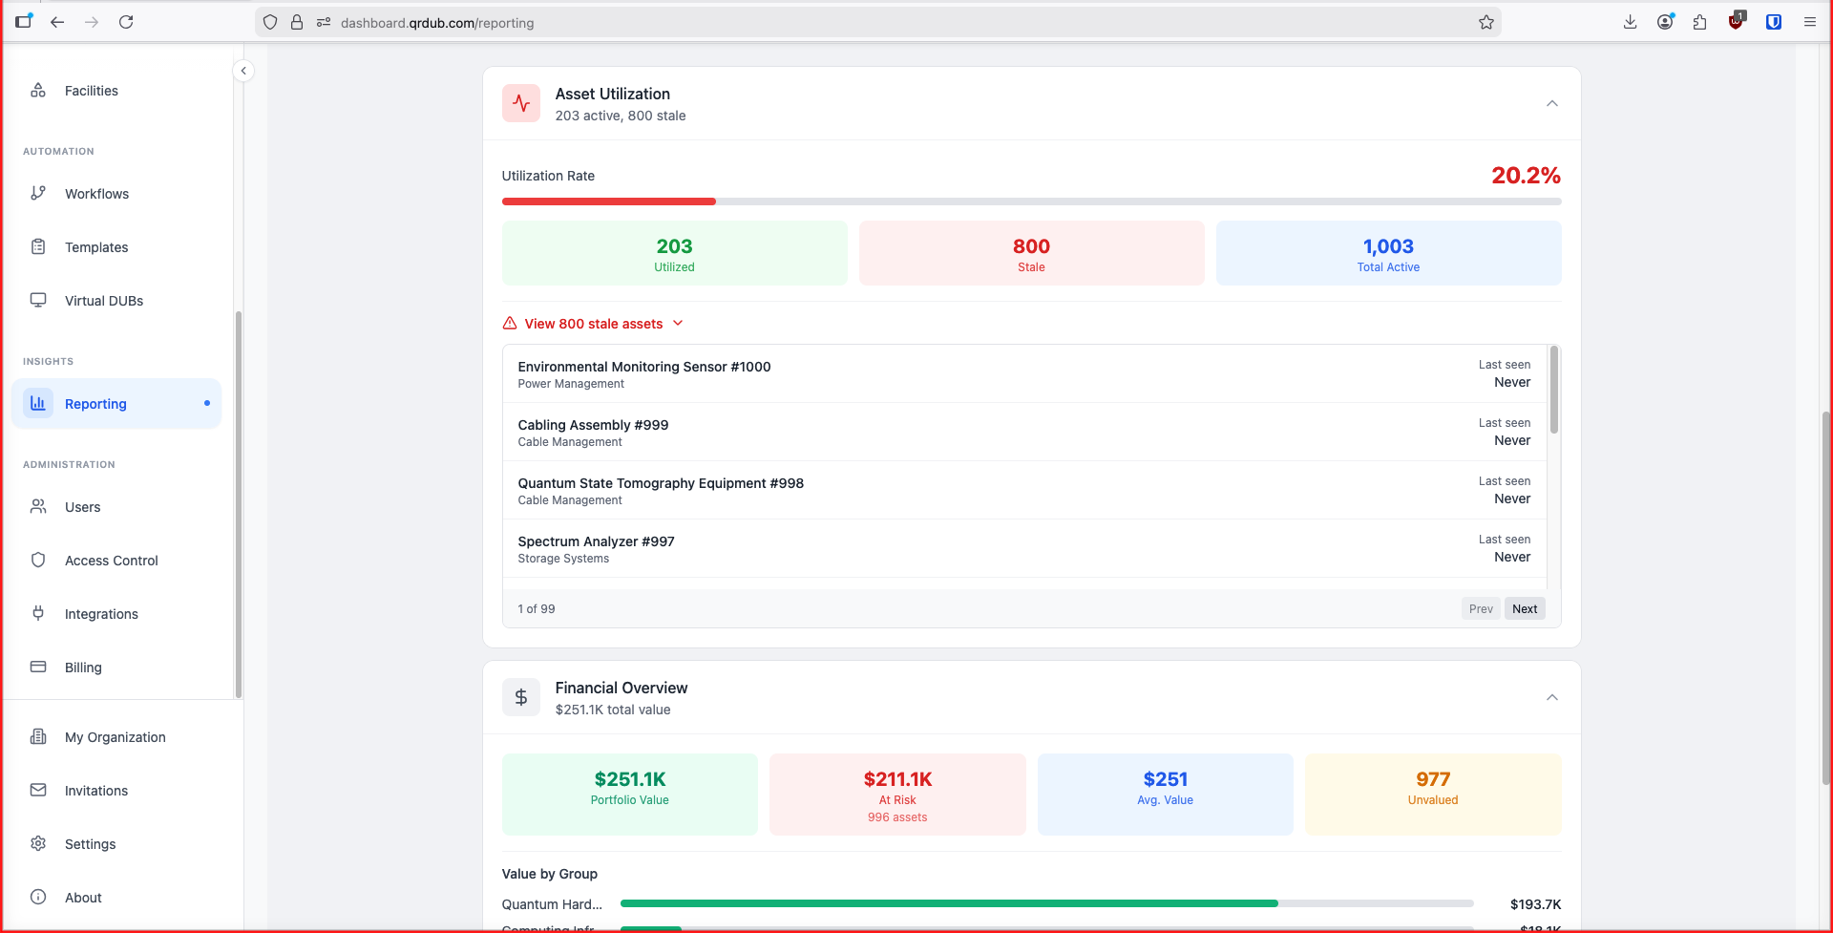
13 — REPORTING & ANALYTICS
ALL YOUR NUMBERS, ONE SCREEN
Utilization, value, and engagement — at portfolio scale.
ACTIVITY & ENGAGEMENT TRENDS
UTILIZATION & FINANCIAL OVERVIEW
/ reporting
/ reporting / financial
REPORTING & ANALYTICS
13 / 18

Slide 14
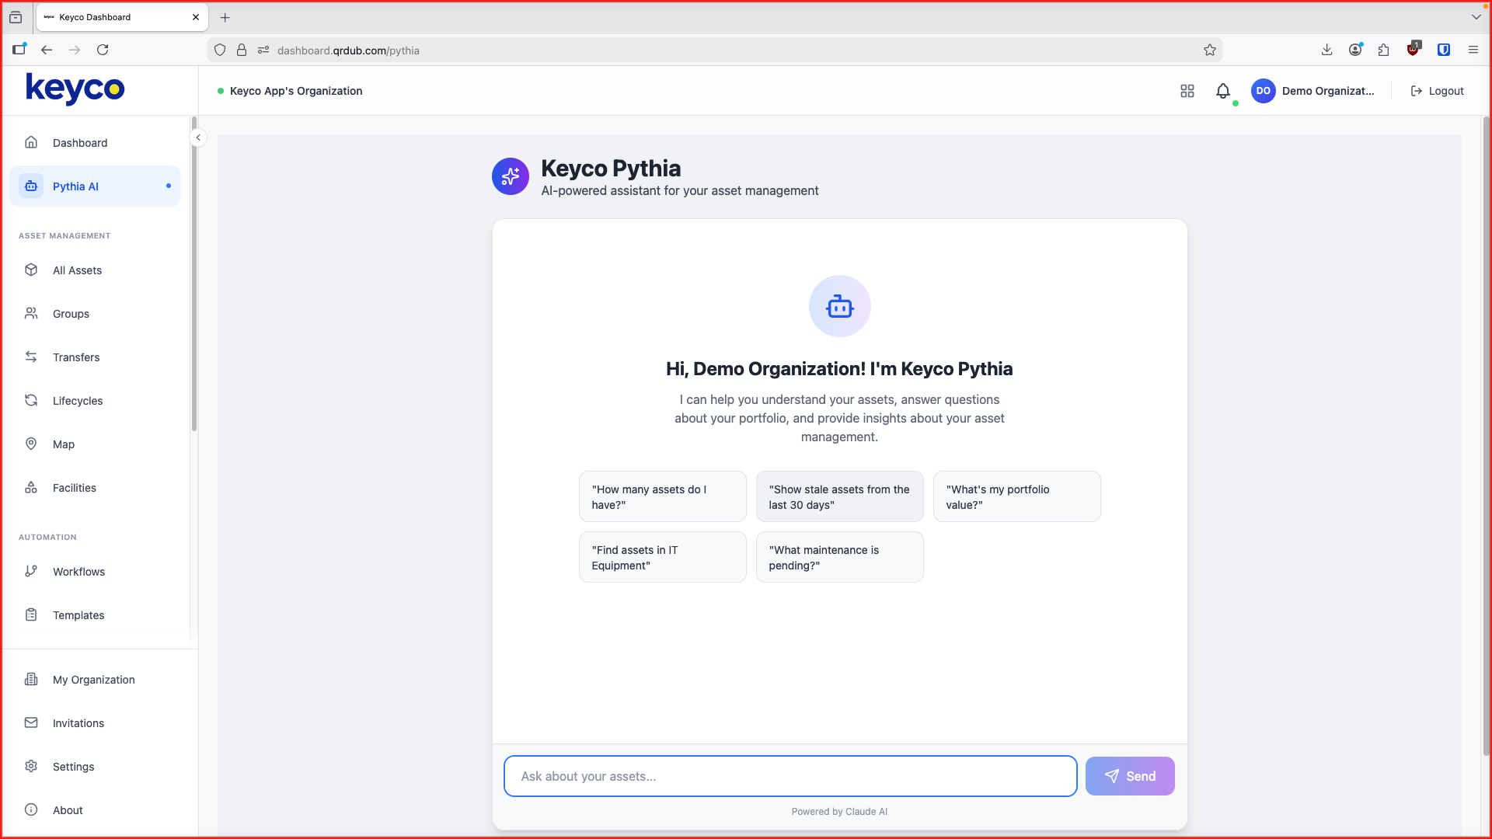
14 — PYTHIA AI
/ pythia
POWERED BY CLAUDE
Ask your portfolio anything.
Pythia turns natural language into instant answers across your entire asset estate. No query language, no spreadsheets, no waiting on IT.
24 / 7 anomaly detection Continuous compliance scoring
PYTHIA AI
14 / 18

Slide 15
15 — THE KEYCO AGENT
NEW · APRIL 2026
Your assets, now agent-native.
Every Keyco customer ships with a built-in AI agent that can see, reason about, and act on the entire asset estate — with the audit trail preserved by design.
01 — DEVELOPER SURFACE
02 — AGENT CONTRACT
03 — DISTRIBUTION
Keyco CLI
SKILL.md
ClawHub listing
Full Keyco API as a scriptable, auditable command line. Bulk ops, CI/CD, no custom REST glue.
MIT-licensed agent skill that teaches any AI assistant how to drive Keyco safely — including what it cannot do.
One-click install for Claude, Cursor, and any ClawHub-compatible assistant. No engineering. Live today.
INCLUDED IN EVERY KEYCO TIER · GITHUB.COM/KEYCO-MAGIX-INC/KEYCO-SKILL
THE KEYCO AGENT
15 / 18

Slide 16
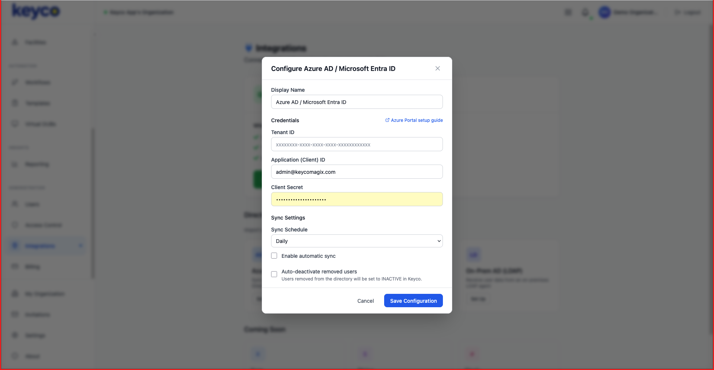
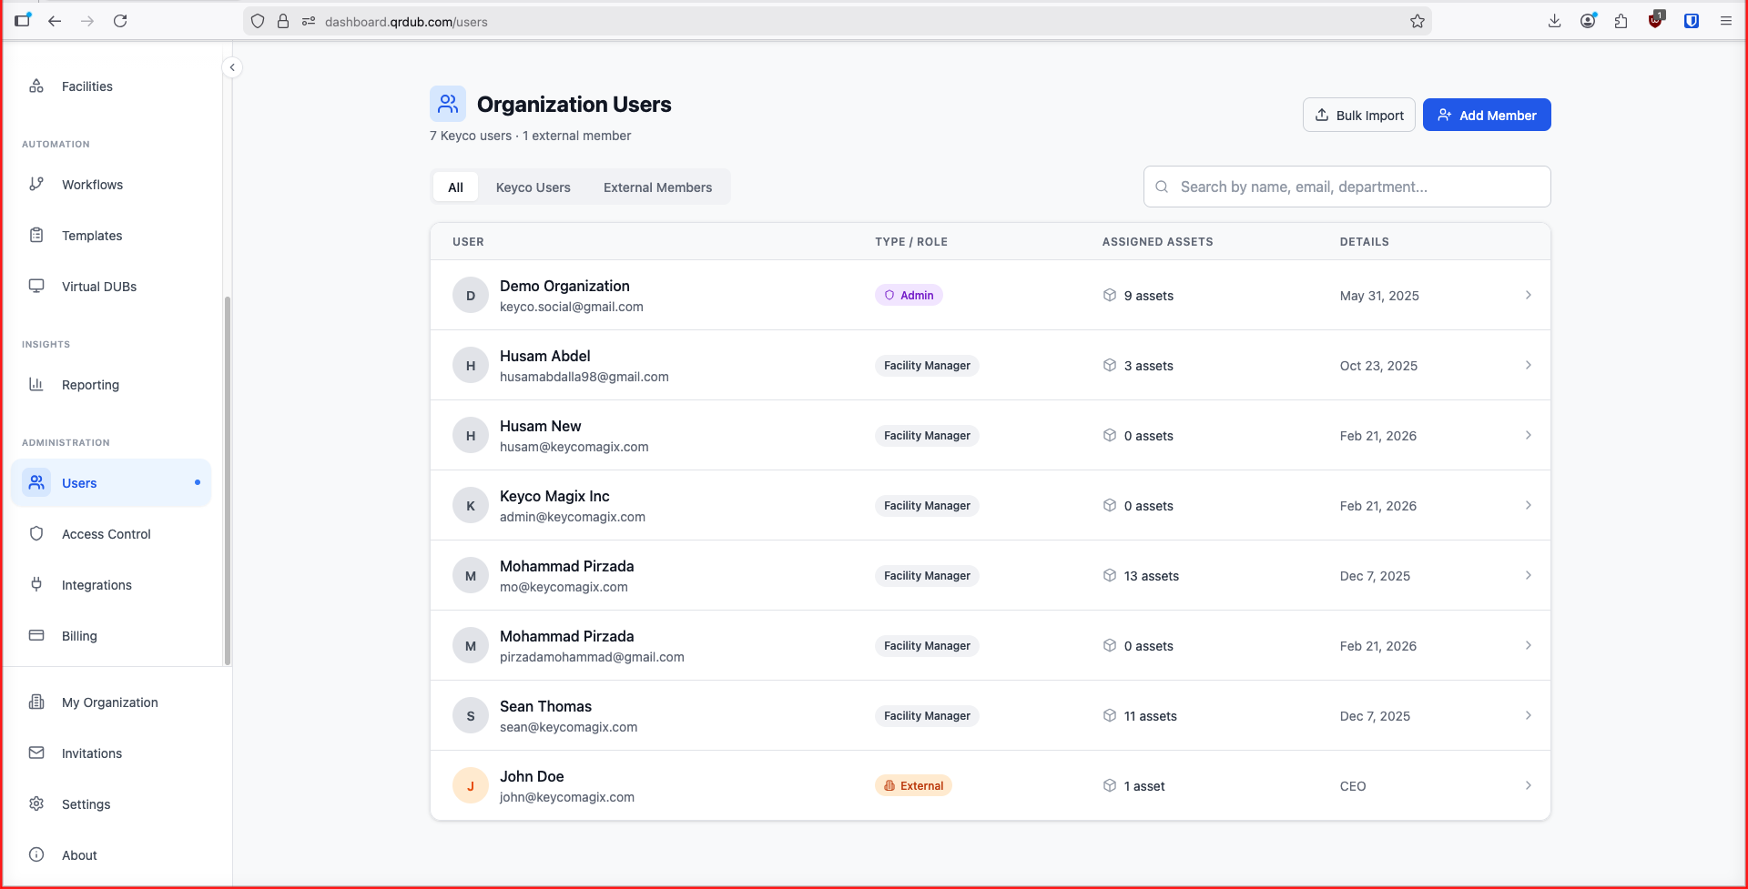
16 — ENTERPRISE INTEGRATION & ACCESS
ENTERPRISE INTEGRATION
Plug into your existing stack.
AZURE AD / ENTRA ID DIRECTORY SYNC
ROLE-BASED USER MANAGEMENT
/ integrations / azure-ad
/ users
Single sign-on, automatic deactivation of removed users, and granular RBAC across every facility.
ENTERPRISE INTEGRATION
16 / 18

Slide 17
17 — HOW KEYCO COMPARES
SIDE-BY-SIDE
No other platform does what Keyco does.
CAPABILITY
KEYCO
ASSET PANDA
IBM MAXIMO
SERVICENOW
CGI SUNFLOWER
Physical Identity Gating (patented)
✓ Yes
— No
— No
— No
— No
Ghost asset prevention
✓ Yes
— No
— No
— No
— No
QR + NFC + BLE tags
✓ Yes
~ Partial
~ Partial
— No
~ Partial
Batteryless BLE tracking
✓ Yes
— No
— No
— No
— No
Real-time GPS map
✓ Yes
— No
~ Limited
~ Limited
— No
Geofencing & alerts
✓ Yes
— No
~ Limited
~ Limited
— No
AI-powered assistant
✓ Yes
— No
~ Limited
~ Limited
— No
Lifecycle management
✓ Yes
~ Basic
✓ Yes
✓ Yes
✓ Yes
Azure AD integration
✓ Yes
— No
✓ Yes
✓ Yes
~ Limited
API-first architecture
✓ Yes
~ Limited
✓ Yes
✓ Yes
~ Limited
Zero infrastructure required
✓ Yes
✓ Yes
— No
— No
✓ Yes
Government / SLED ready
✓ Yes
— No
✓ Yes
✓ Yes
✓ Yes
HOW KEYCO COMPARES

Slide 18
18 — WHY KEYCO
SIX DEFENSIBLE ADVANTAGES
Why Keyco wins.
Patented technology
Zero infrastructure
Batteryless BLE
Physical Identity Gating — 3 patents awarded, defensible IP.
No RFID readers, no wiring. Deploy in minutes.
Energy-harvesting trackers, 10+ year lifespan.
API-first platform
Compliance ready
Government access
Integrates with any ERP, CMMS, or custom system.
SOX, HIPAA, ISO 55000, DFARS — audit trails out of the box.
Active federal relationships + legislative tailwind via HR 3494.
GET IN TOUCH
TAG. TRACK. TRUST.
hello@keycoai.com
Deploy in minutes.
www.keycomagix.com
Northern Virginia · Founded 2017
KEYCO INC.
18 / 18

