Slide 1
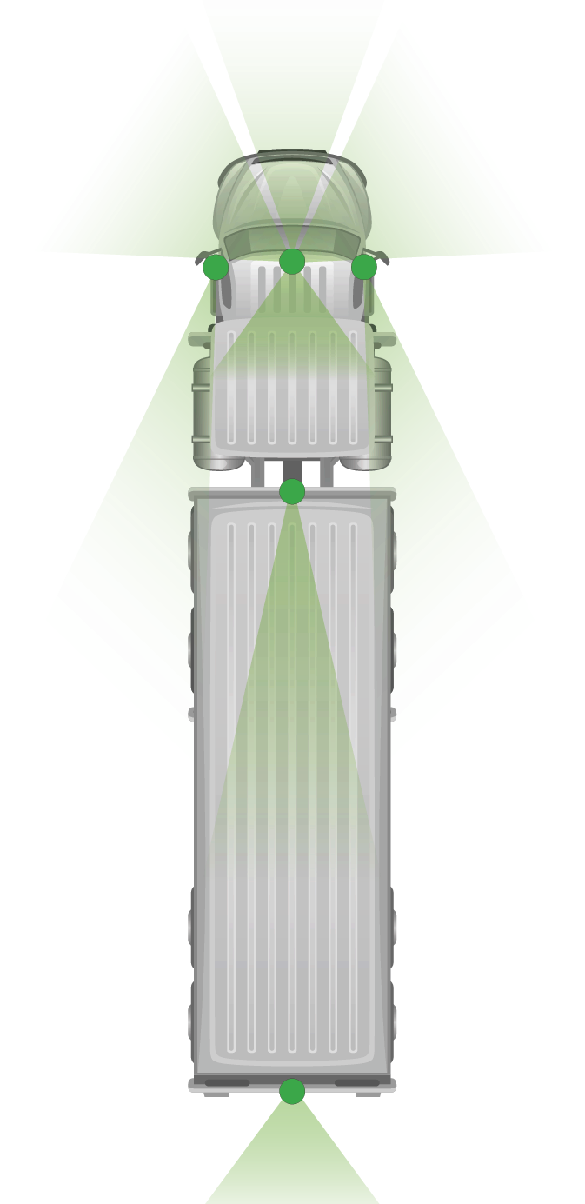






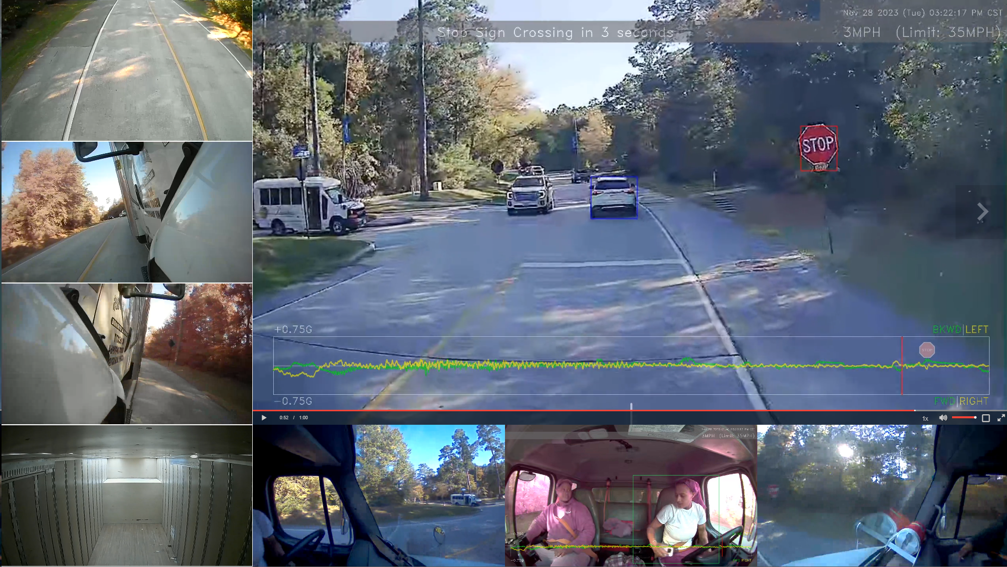

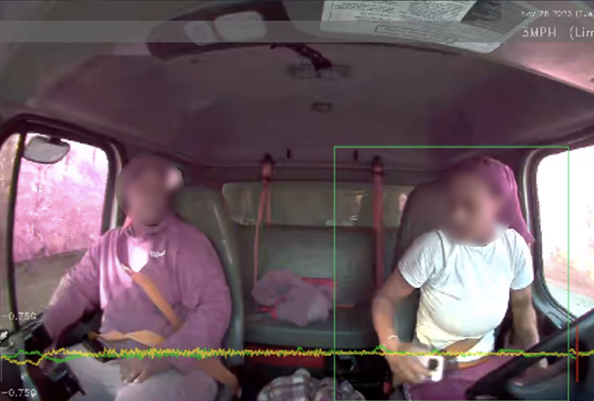

360 AI Camera Coverage
AVAILABLE NOW
Complete visibility for heavy-duty towing & recovery
D450 Quad camera
Front view.
Aux. camera
Left side view.
D450 Quad camera
Internal view.
Aux. camera
Right side view.
D450 Quad camera
Left side view.
Aux. camera
Interior view.
*Performance may be reduced in poor visibility, including rain, fog, glare, or low light conditions.
D450 Quad camera
Right side view.
Aux camera
Rear view.

